Slide 1
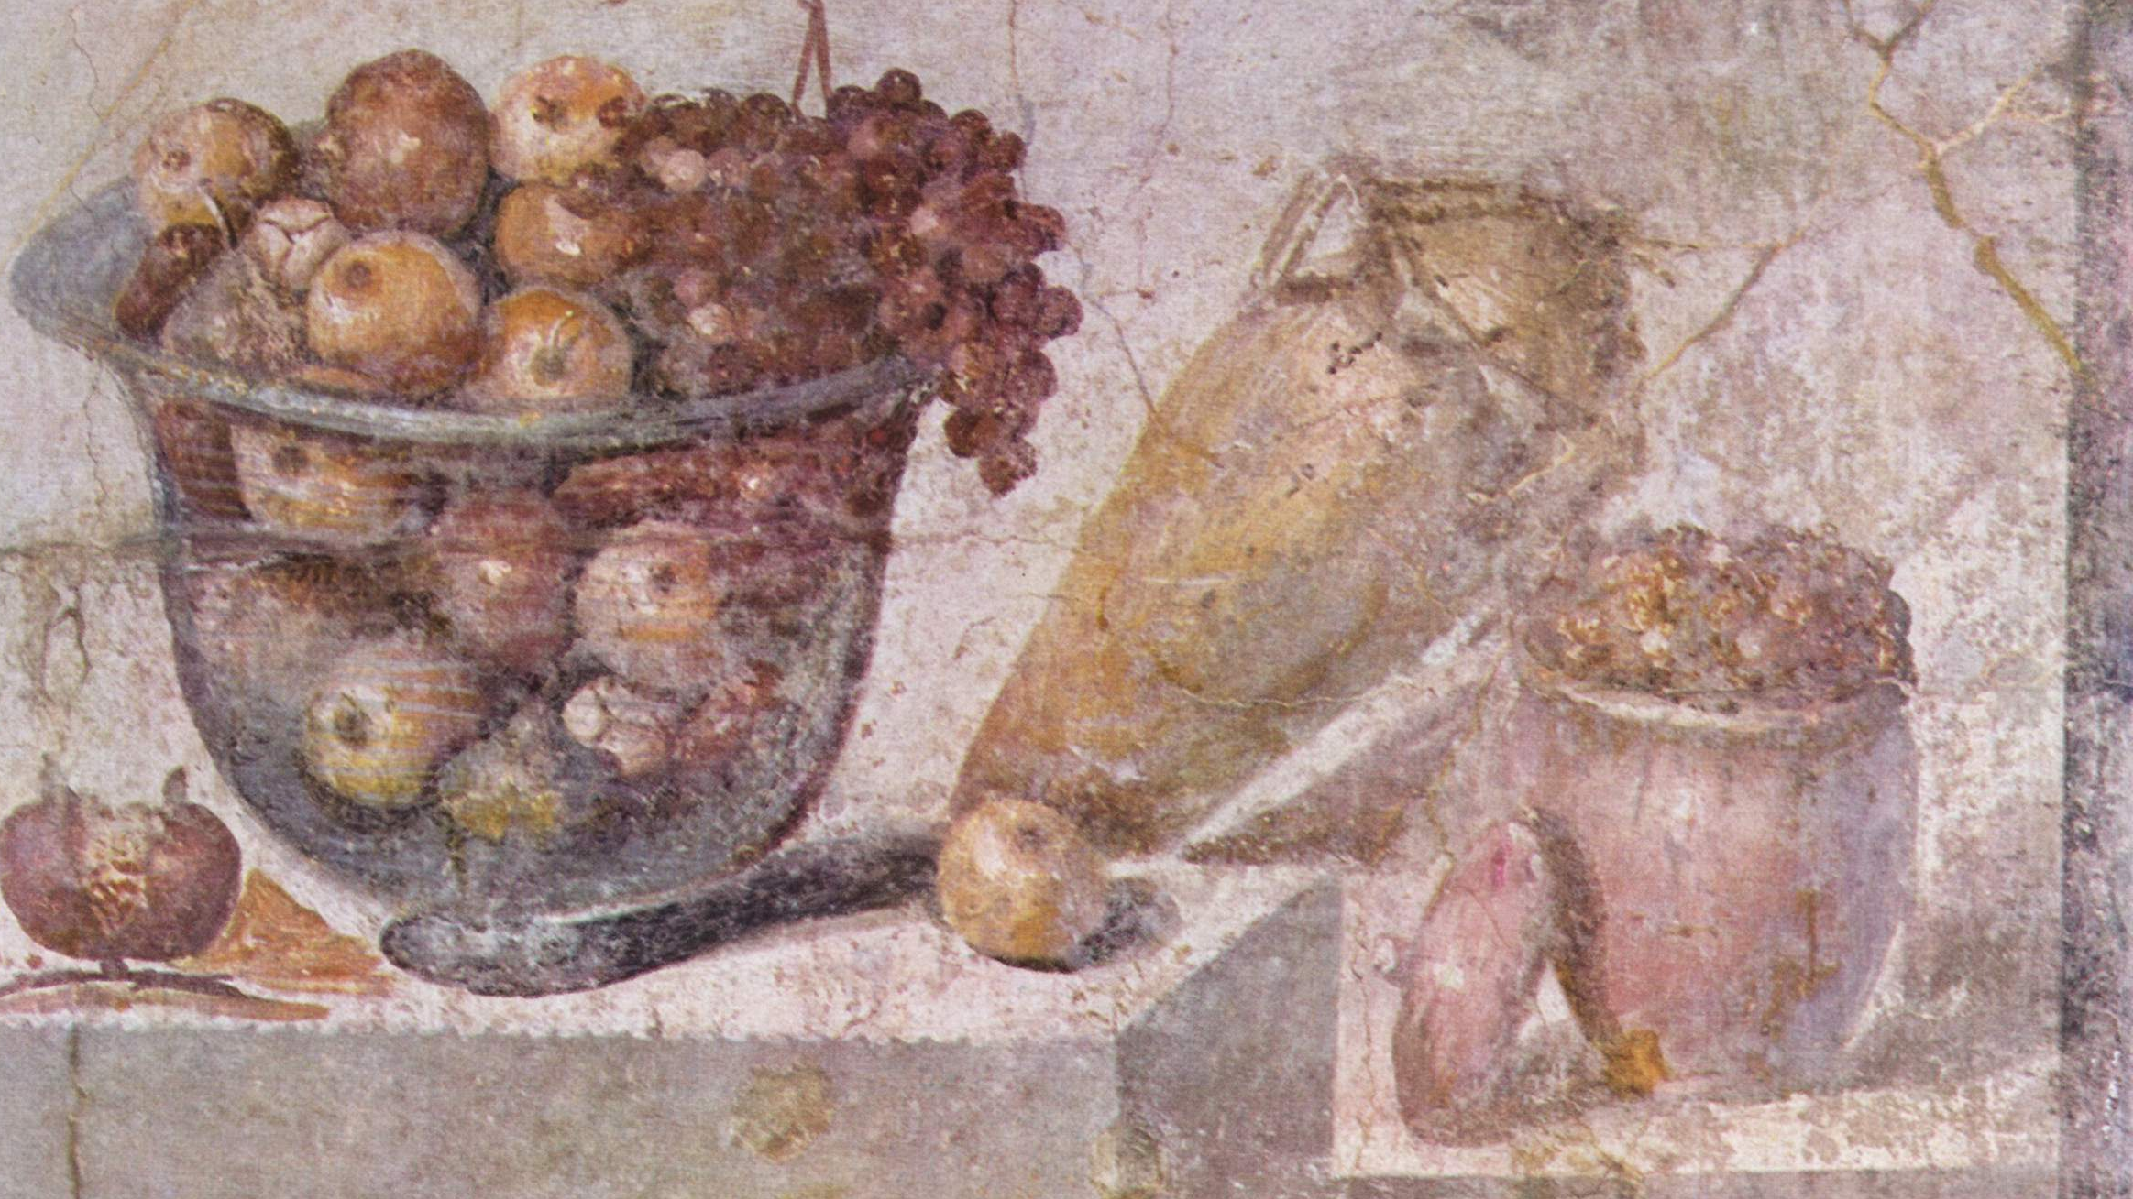
Appetitus rationi pareat
De Officiis – On Duties
Book I, section 141
Desire ought to obey reason
What Meals & Food Would
Cicero Have Eaten?
Naples National Archaeological Museum [Public domain], via Wikimedia Commons

Slide 2
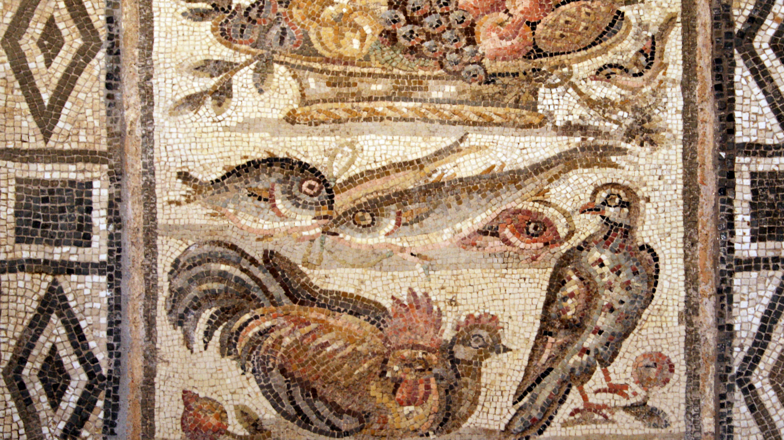
Agenda
Palazzo Massimo alle Terme [CC BY-SA 3.0 (https://creativecommons.org/licenses/by-sa/3.0) or GFDL (http://www.gnu.org/copyleft/fdl.html)], via Wikimedia Commons
Finding books
A few key resources for Classics
Finding articles
Cite your sources
Search on your own

Slide 3
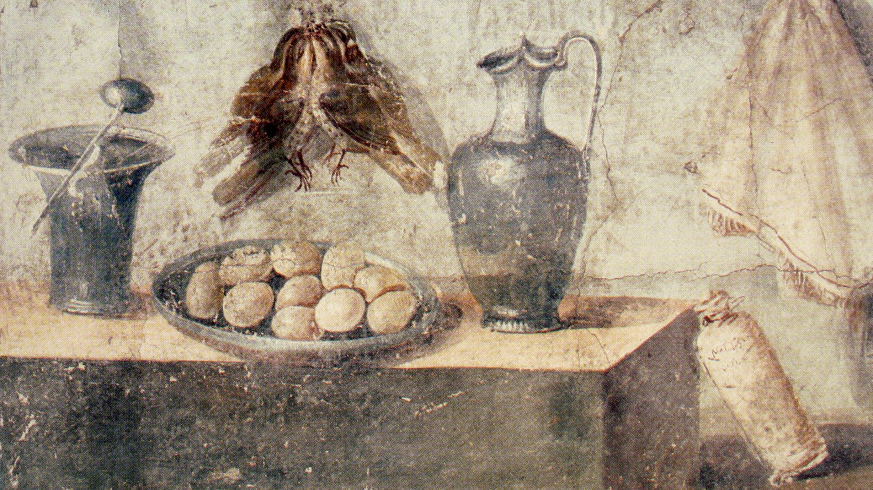
Start General
Try to define what your question is about:
Question 2 is ultimately a question about food, dinning and meals specific to the culture, social life, and customs of Rome
Nota Bene: Libraries might use special terms
If you can figure out the terms, you can find the resources!
There are always a multitude of sources, so let the experts help point the way:
Professor Phillips
A Research and Instruction Librarian
The sources we will look at
Figure out: is this more likely to be a book topic, or an article topic:
Cutting edge research is frequently found in articles
Established subjects usually have books
Naples National Archaeological Museum [Public domain], via Wikimedia Commons

Slide 4
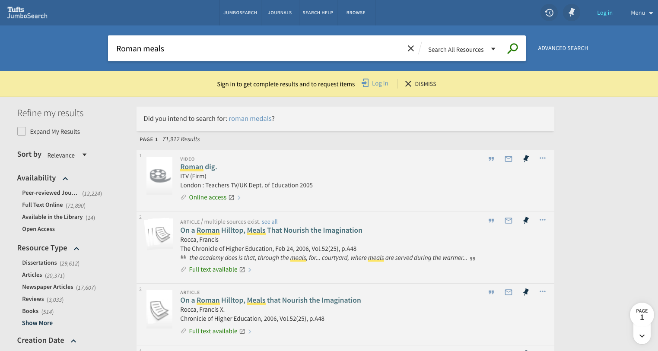
General Catalog Search: Recall
Notes:
KW: Roman meals, dinning, etc… = too many results. You need to narrow it down.

Slide 5
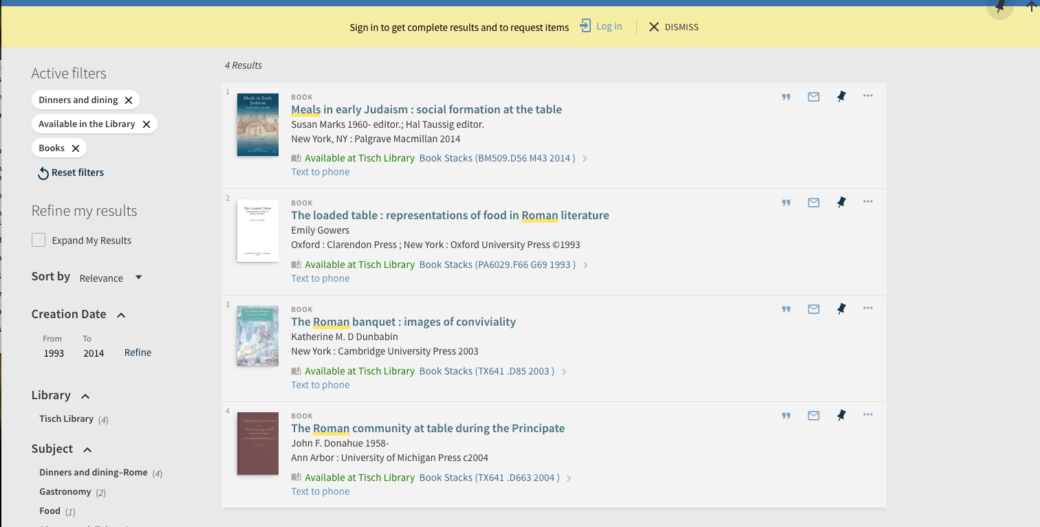
General Catalog Search: precession through Facets
Notes:
If your kw doesn’t surface a potential source, you may want to try facets to help find an item, from which you can get really precise results through the browse function

Slide 6
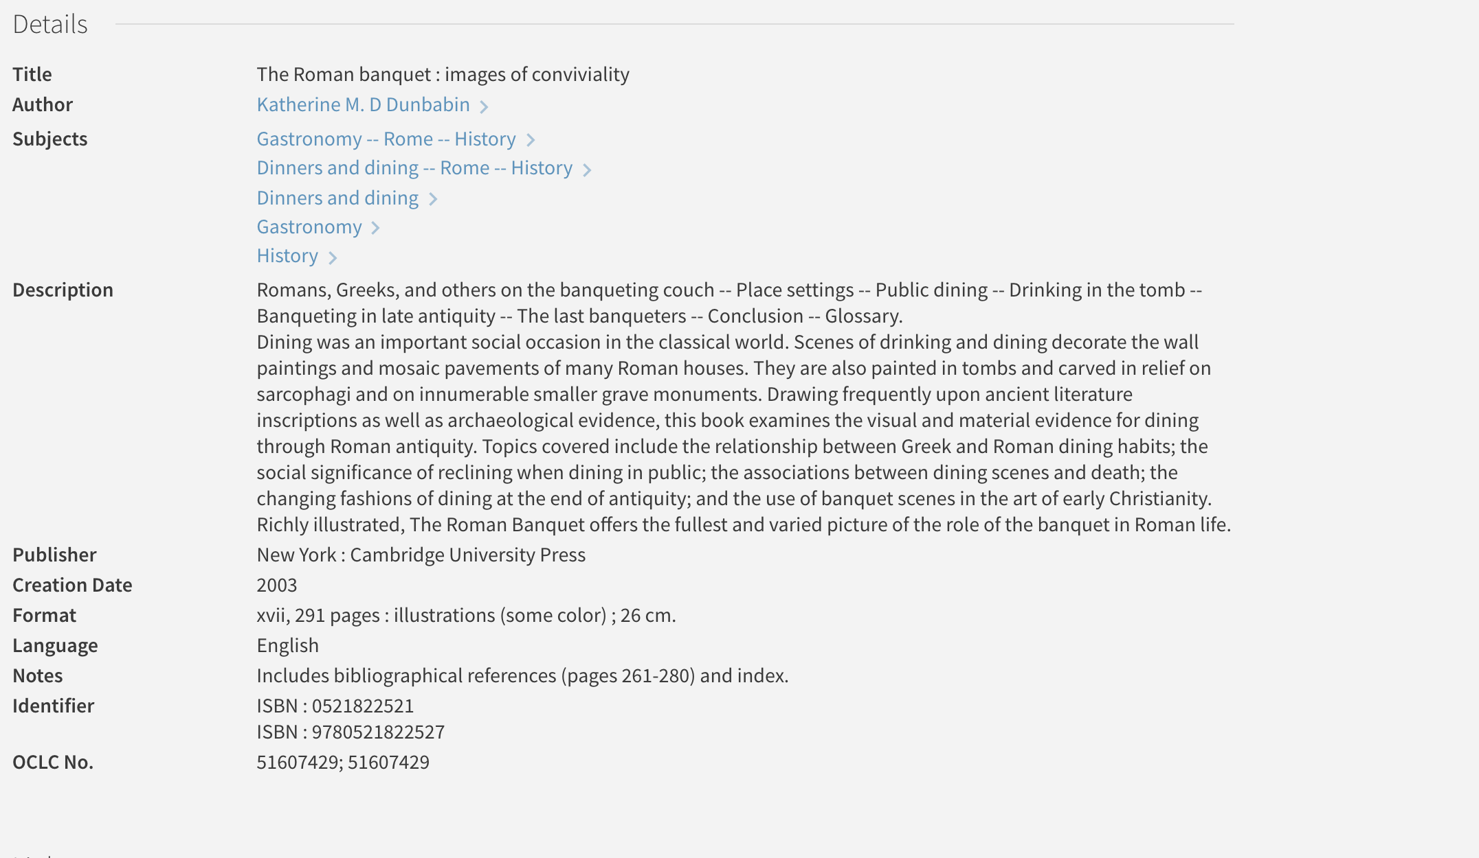
Look for specific terms!

Slide 7
Look for specific terms!
Notes:
* technique 1: follow up on the good items

Slide 8
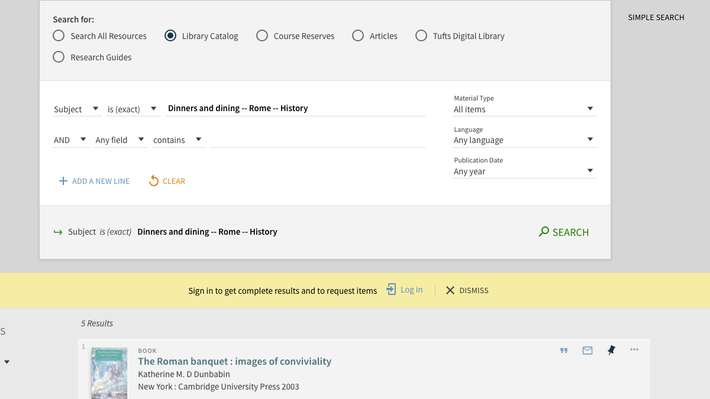
General Catalog Search: Precession through known Subject
Notes:
* technique 1: follow up on the good items—use the subjects you found!

Slide 9
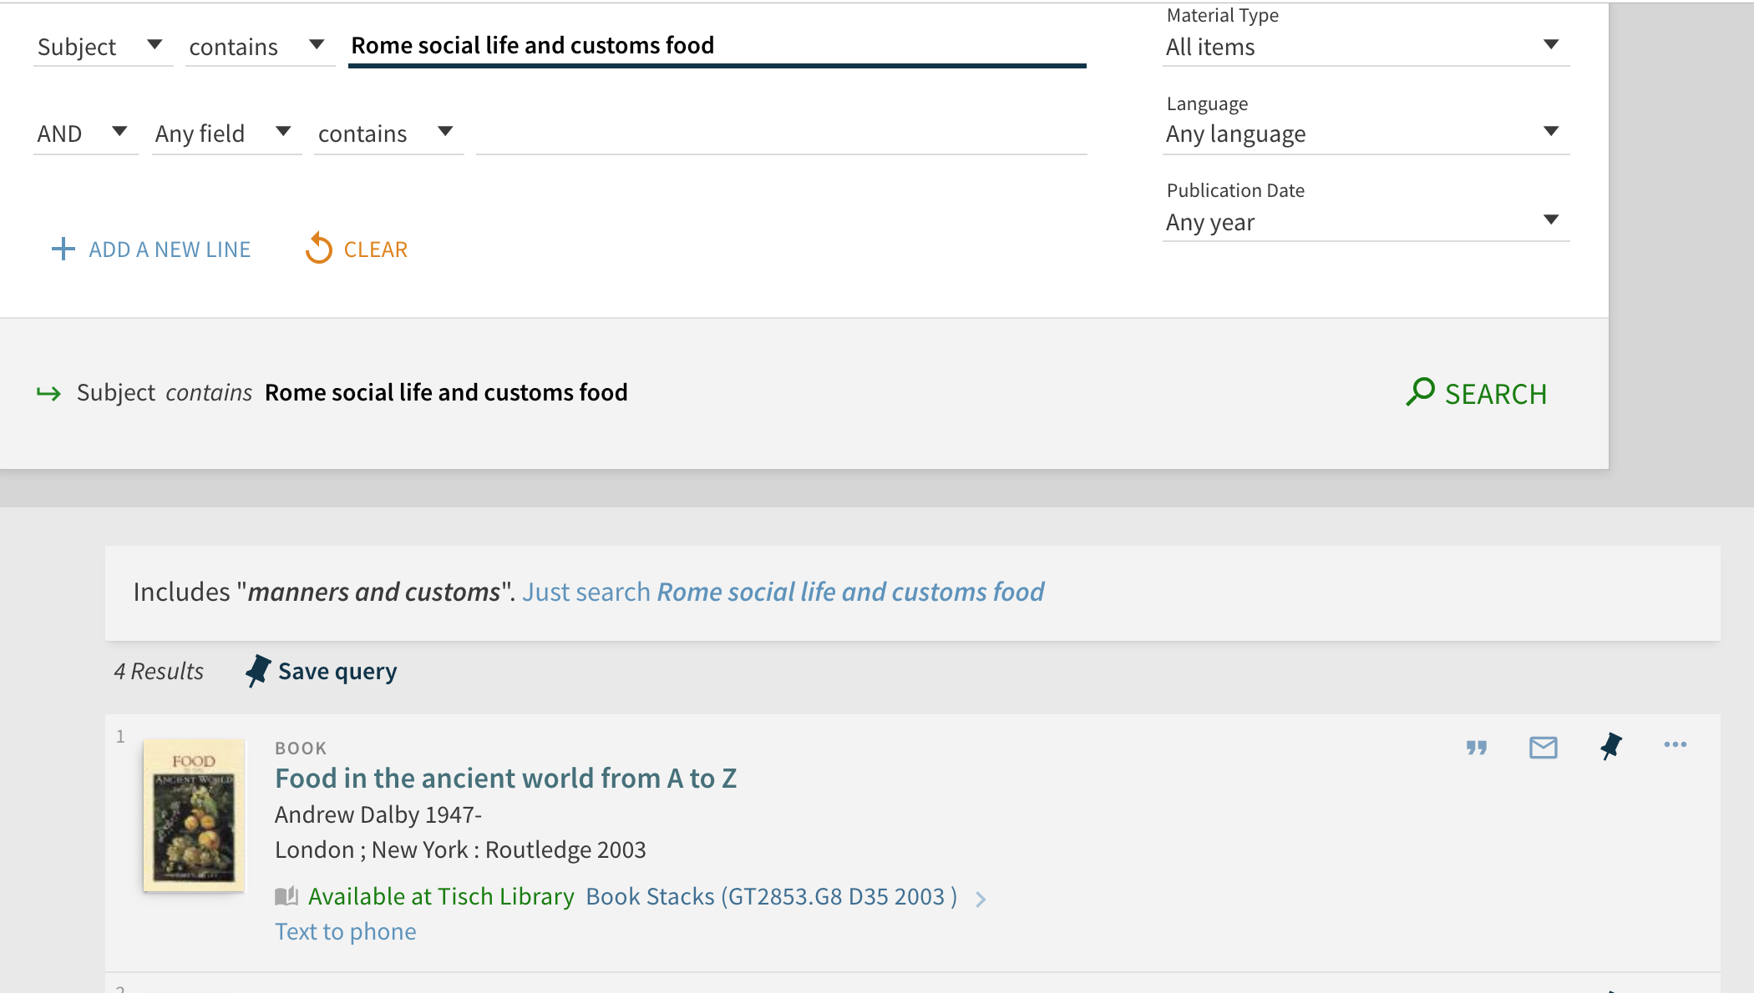
General Catalog Search: Precession through Expanded Subject
Notes:
* technique 2: SU: Rome social life and customs
* other useful searches:
* KW rome social life (your topic)
* KW (rome or roman) (your topic)

Slide 10
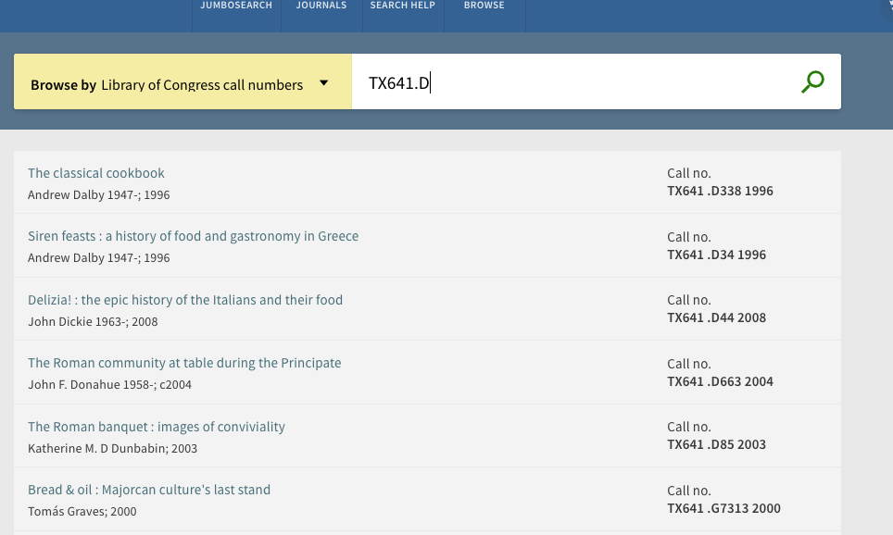
General Catalog Search: Precession through Call Number Browse
Notes:
You can also browse by title, author, and call number.. Try browsing for: Z5

Slide 11
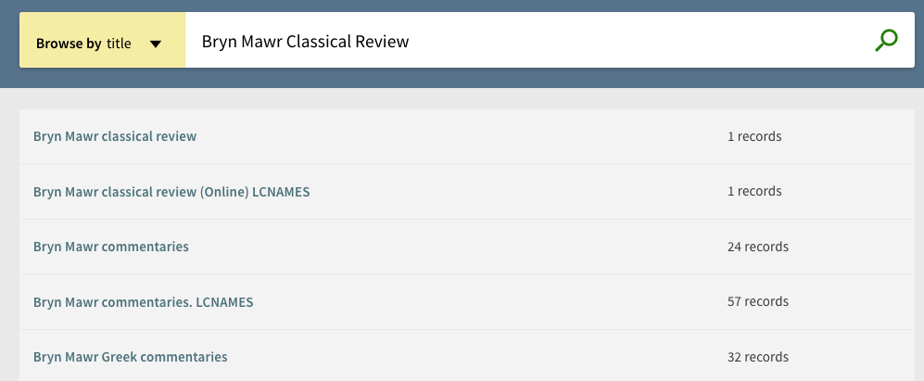
General Catalog Search: Precession through Title

Slide 12
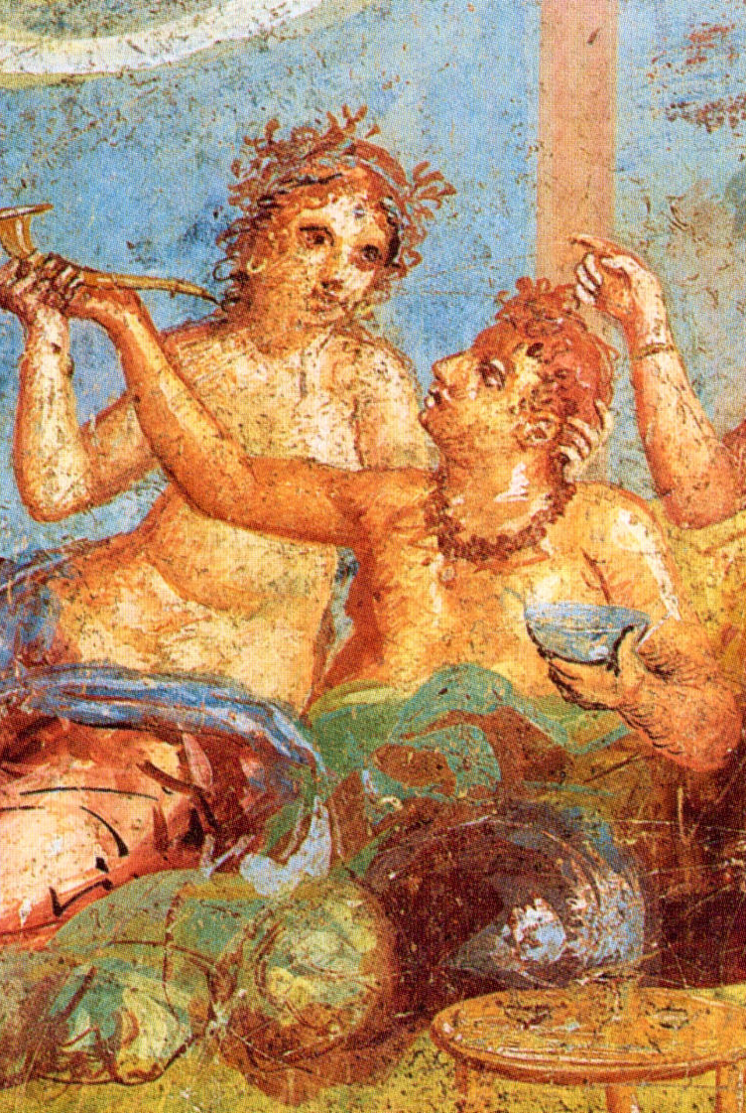
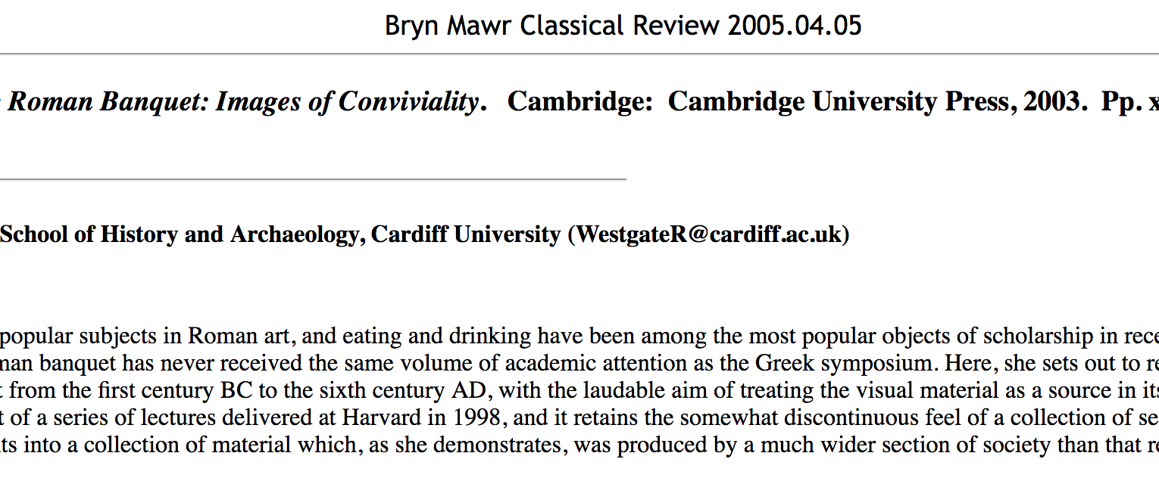
When in doubt about a resource: check!
By WolfgangRieger [Public domain], via Wikimedia Commons

Slide 13
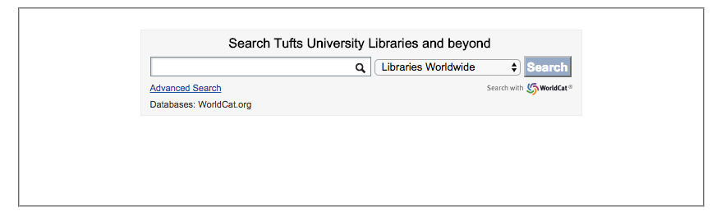
When you need to go Beyond…
BLC provides seamless access to millions of books through the Boston Library Consortium and research libraries worldwide.
BLC delivery time: usually 2-3 days
Interlibrary loan delivery time: usually 7-10 days, sometimes less

Slide 14
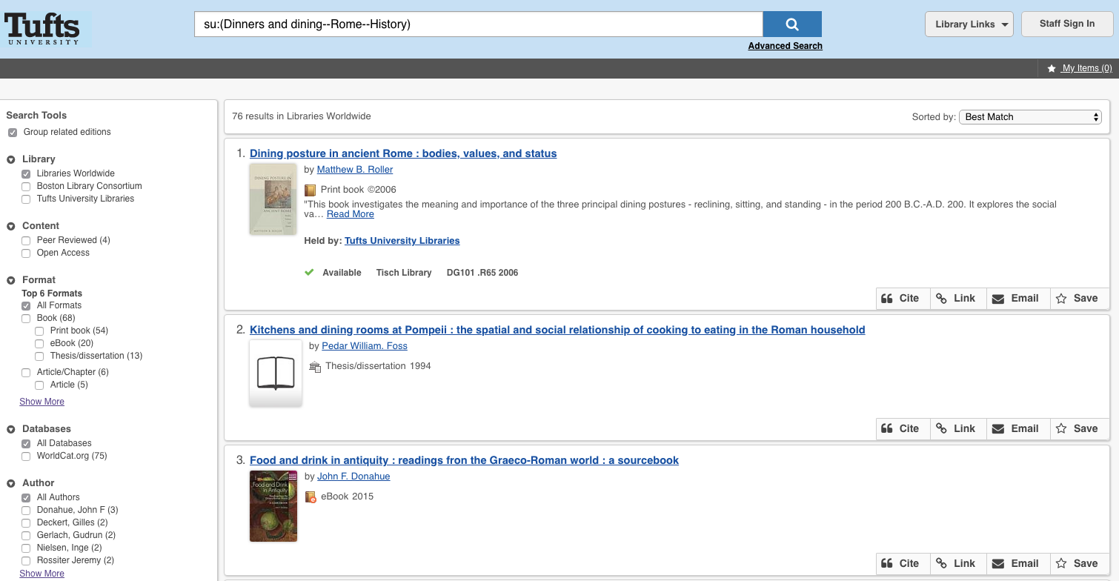

Slide 15
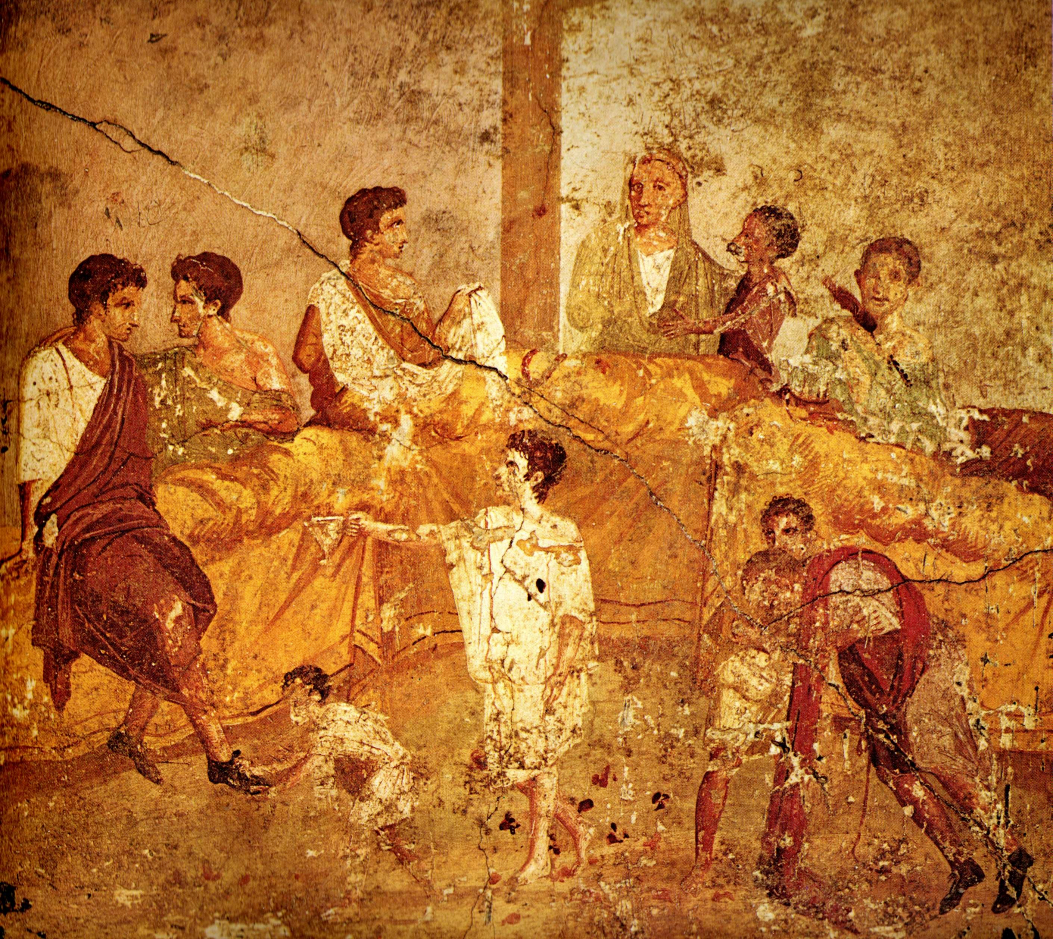
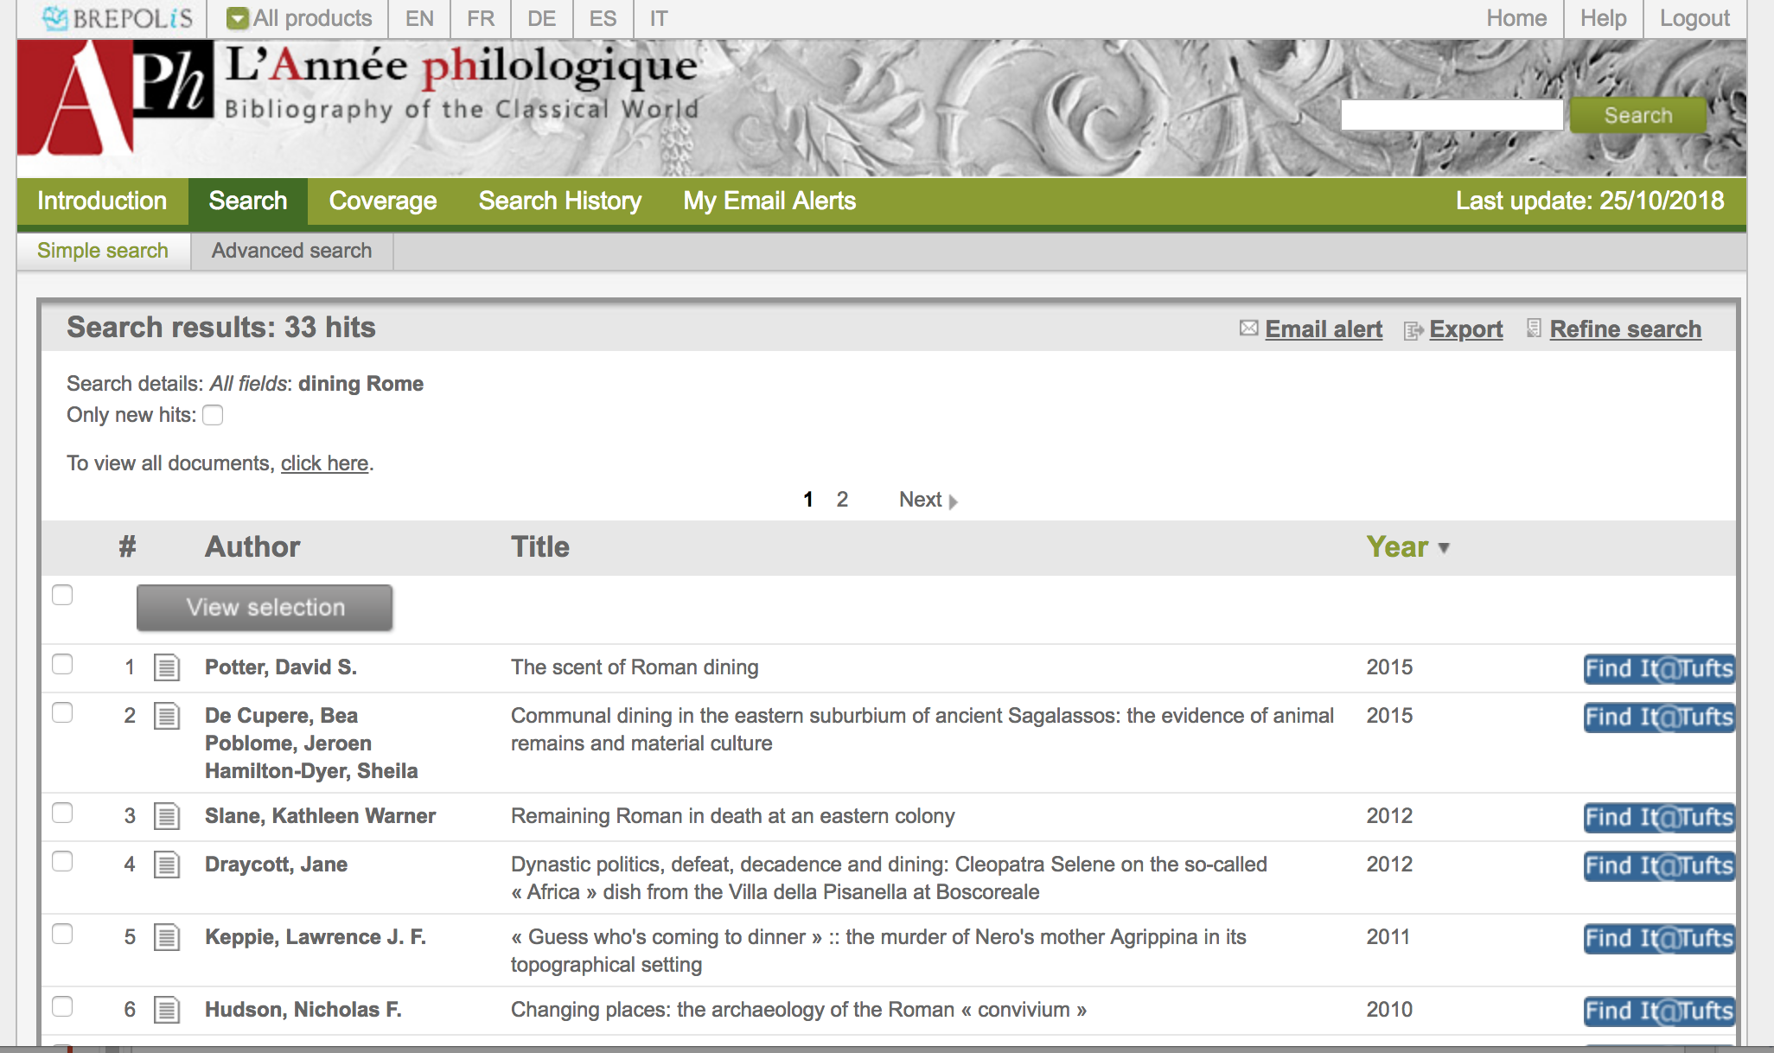
L’Année philologique
Naples National Archaeological Museum [Public domain], via Wikimedia Commons
Notes:
L'année philologique
* books, articles, dissertations, everything relevant to Classics published anywhere.
* it's in many languages.
* there is no full text
NOTE: The subjects used in L’Annee are not the same as those used in libraries….

Slide 16
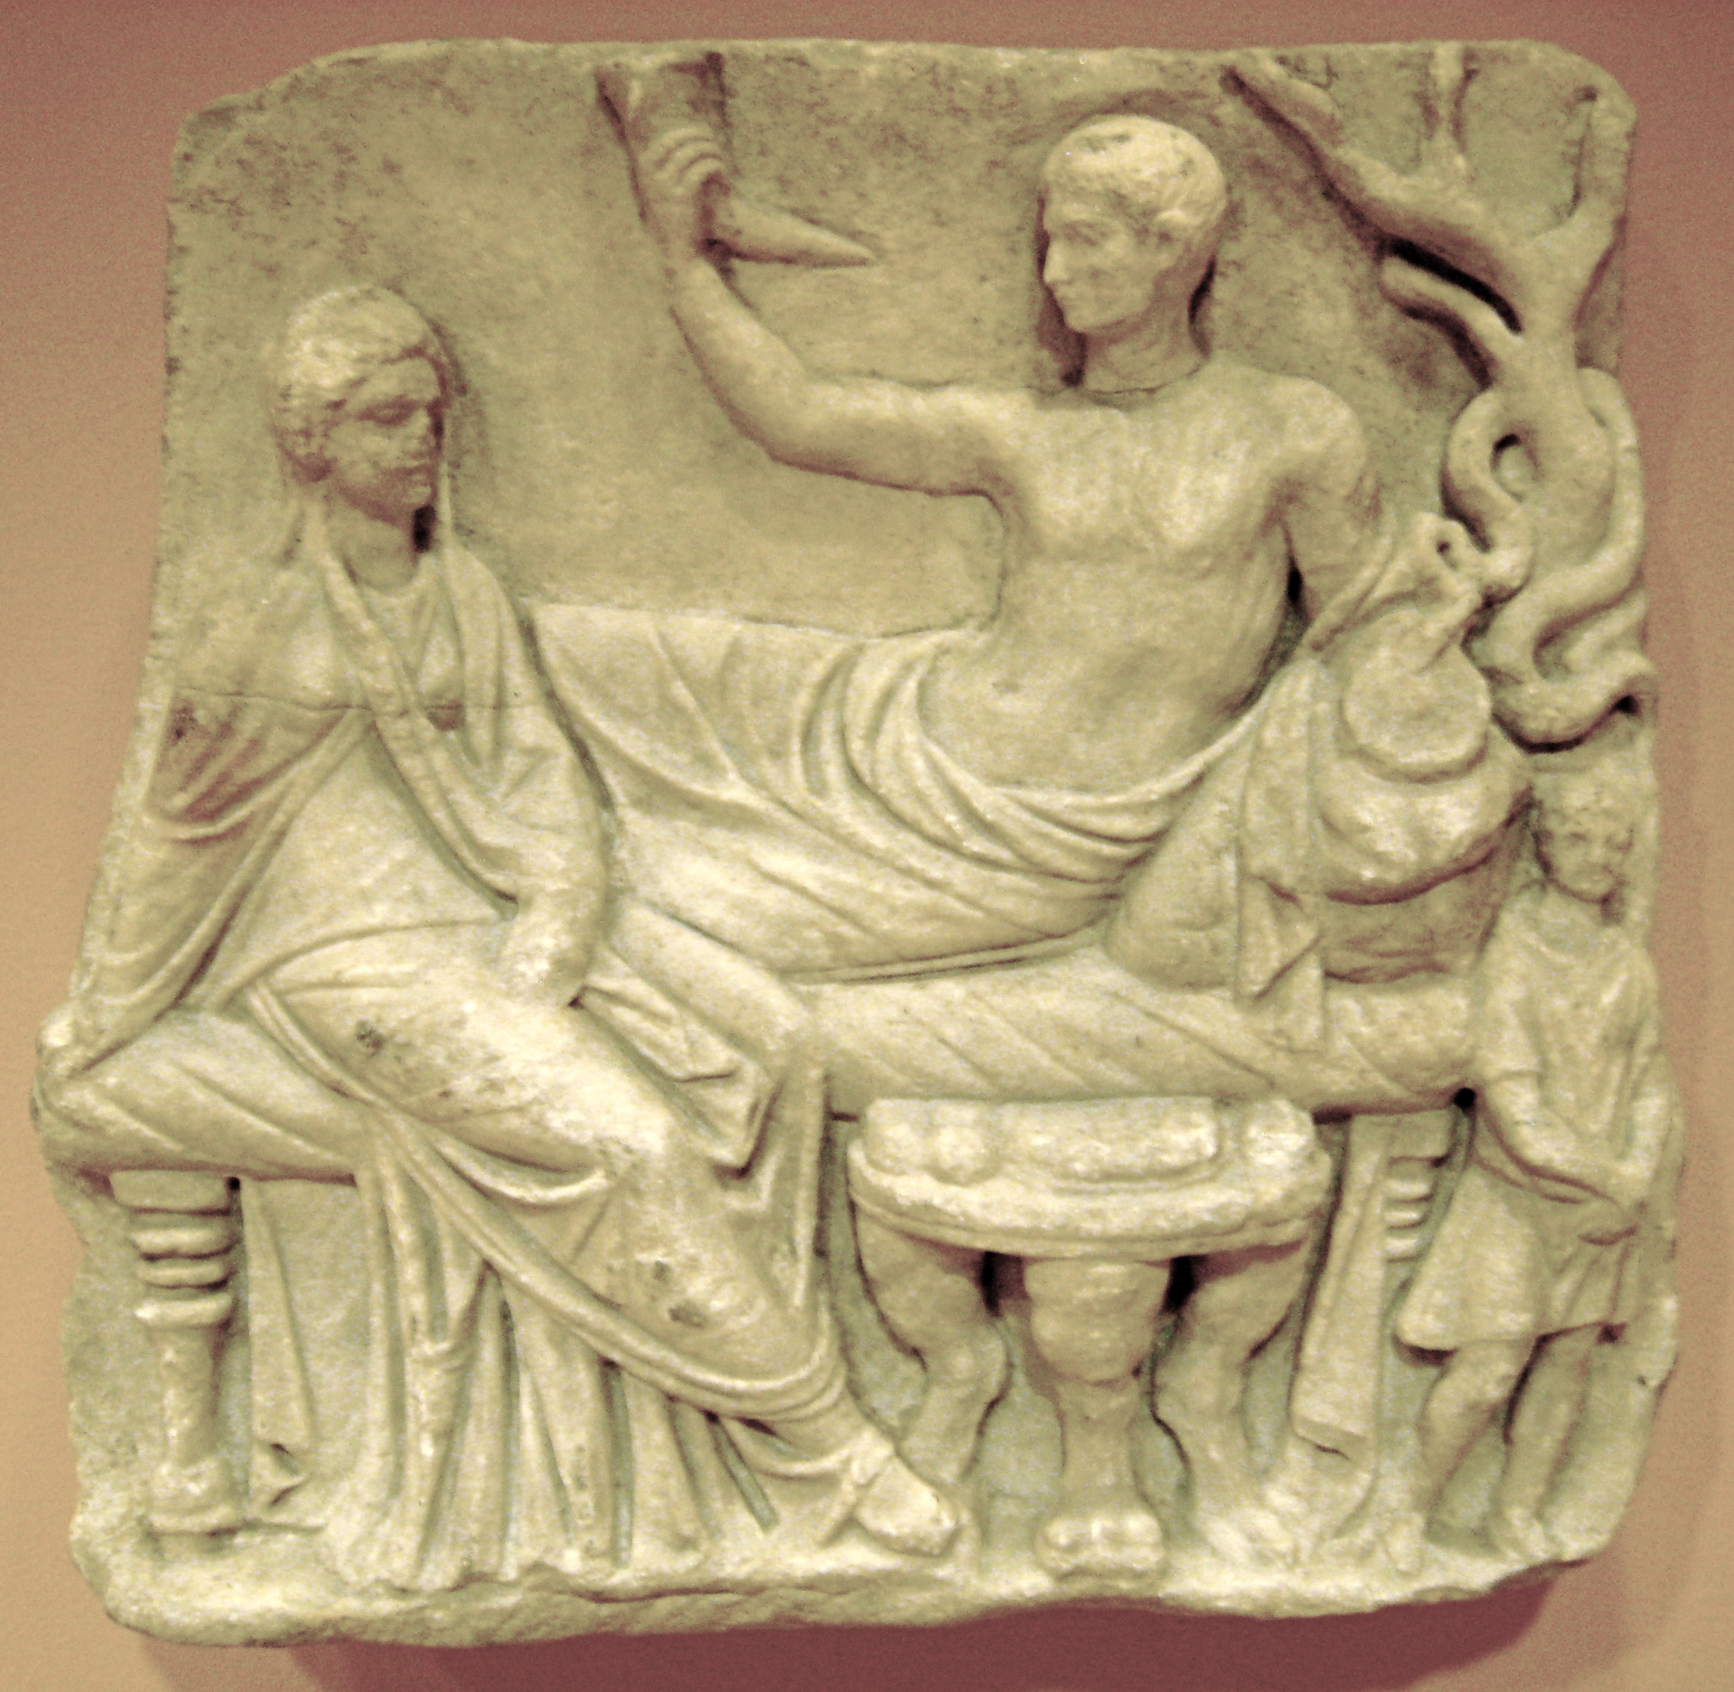
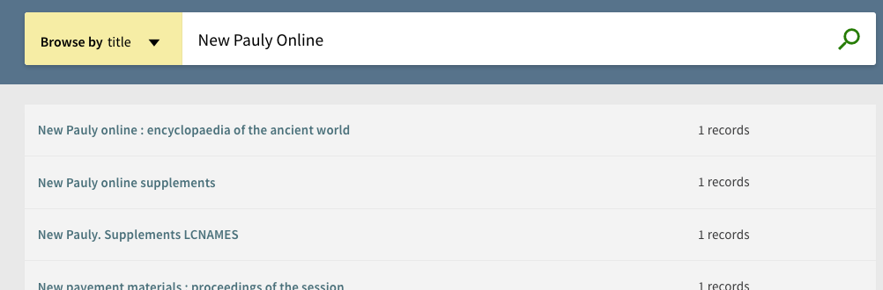
New Pauly Online
By McLeod (self-made @ National Museum, Copenhagen) [Public domain], via Wikimedia Commons
Notes:
A comprehensive encyclopedia of antiquity, with solid coverage of topics famous and obscure. Need a biography of Pseudo-Skimnos? This is the place. We also have a comprehensive collection of prior editions in the Pauly series.

Slide 17
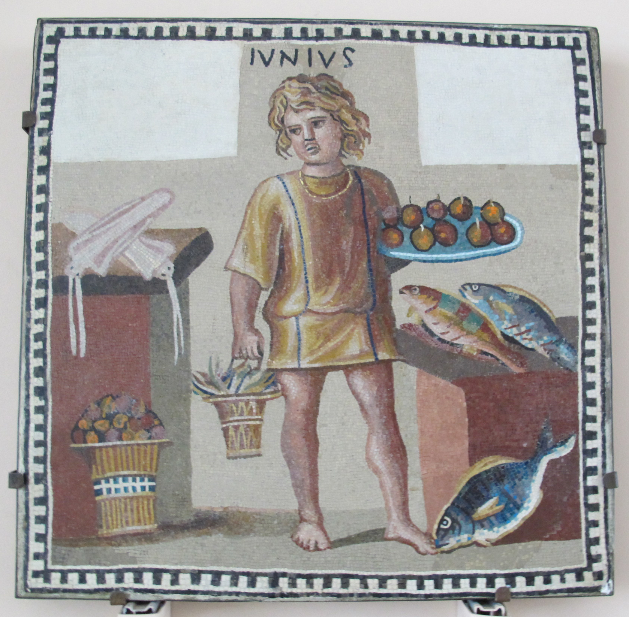
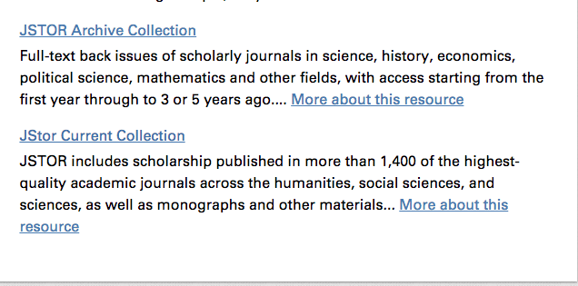
Finding Articles
I, Sailko [GFDL (http://www.gnu.org/copyleft/fdl.html) or CC BY-SA 3.0 (https://creativecommons.org/licenses/by-sa/3.0)], from Wikimedia Commons

Slide 18
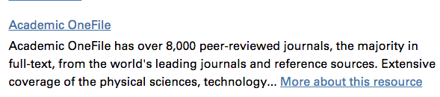
Finding Articles
I, Sailko [GFDL (http://www.gnu.org/copyleft/fdl.html) or CC BY-SA 3.0 (https://creativecommons.org/licenses/by-sa/3.0)], from Wikimedia Commons

Slide 19
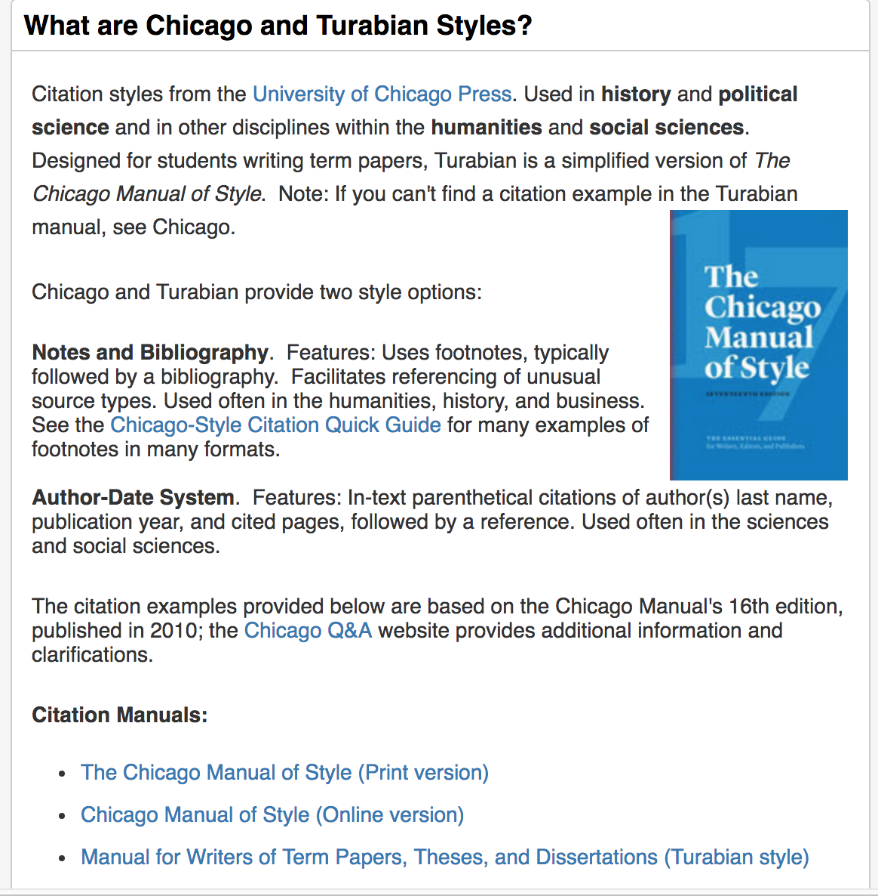
Citing your sources
By UnknownHerkulaneischer Meister (Image:Puh213r1.jpg) [Public domain], via Wikimedia Commons

Slide 20
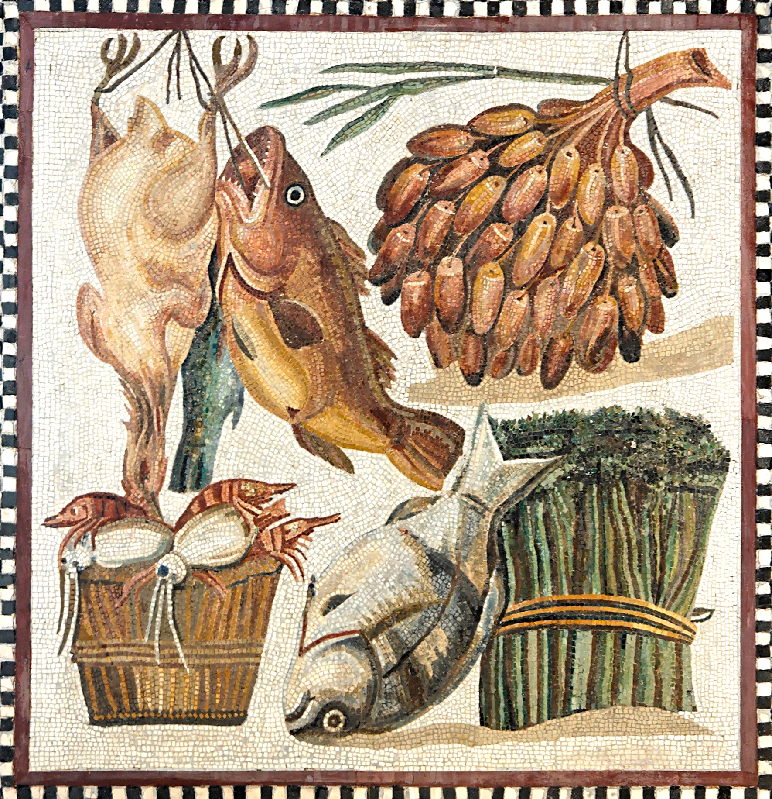
Questions? Alex May Team Lead, Digital Initiatives Tisch Library, Tufts University Alexander.may@tufts.edu 617-627-2399
Vatican Museums [Public domain], via Wikimedia Commons

